Slide 1
Direct and Indirect Speech

Slide 2
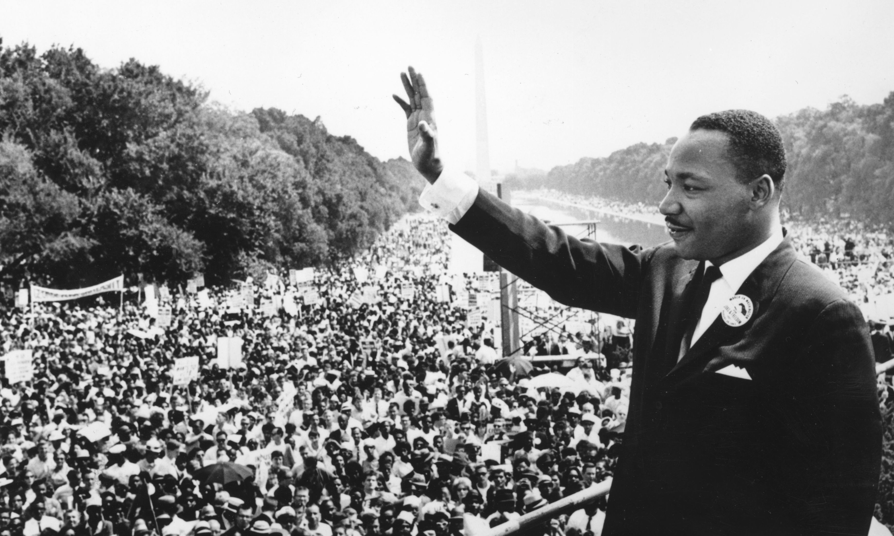
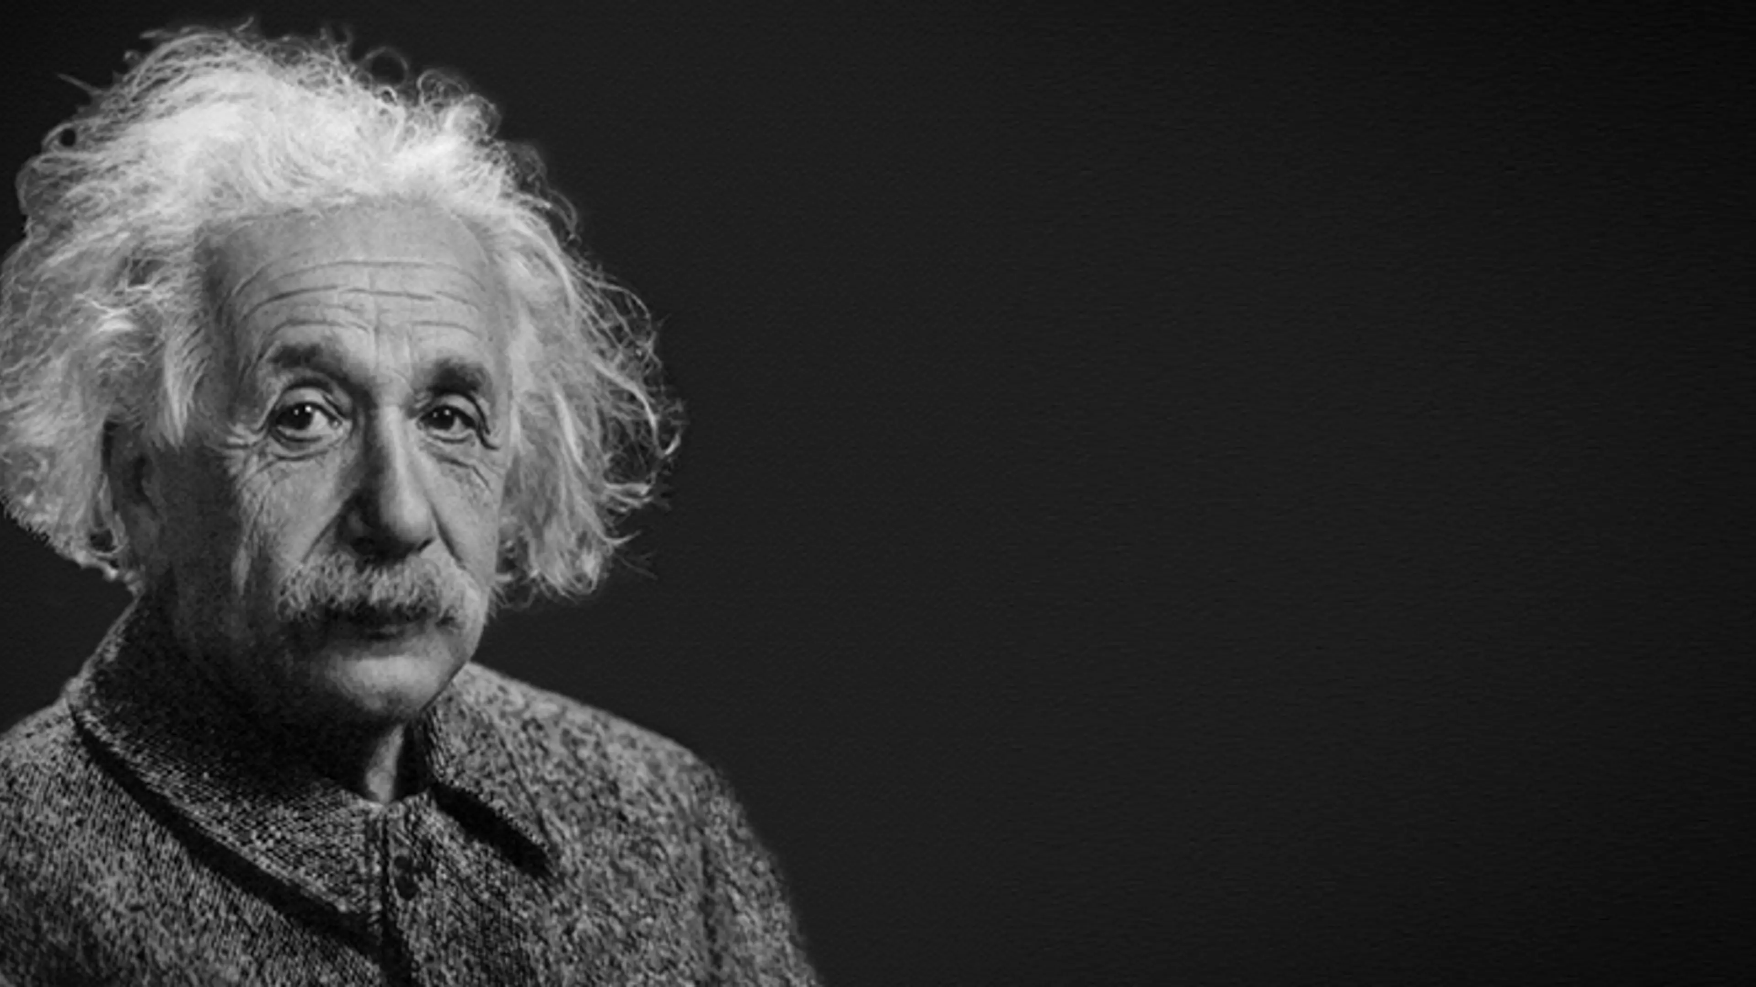
“I have a dream that one day this nation will rise up and live out the true meaning of its creed.”
“Imagination is more important than knowledge. For knowledge is limited, whereas imagination embraces the entire world, stimulating progress, giving birth to evolution.”

Slide 3
Indirect Speech:
Martin Luther King Jr. expressed his dream that one day the nation would rise up and live out the true meaning of its creed.
Indirect Speech:
Albert Einstein believed that imagination was more important than knowledge because knowledge is limited, whereas imagination embraces the entire world, stimulates progress, and gives birth to evolution.

Slide 4
Descriptive Formulations
In indirect speech, descriptive formulations can be used to provide additional information about the speaker, tone, or context. These formulations are usually introduced by a reporting verb (e.g., said, told, asked) and followed by a preposition (e.g., with, in, about).

Slide 5
Examples:
He said with a smile, "I'm going to the store." (becomes) He said with a smile that he was going to the store.
She spoke in a loud voice, "I'm excited!" (becomes) She exclaimed excitedly that she was thrilled.
He asked about the time, "What's the time?" (becomes) He inquired about the time.

Slide 6
Some common Descriptive Formulations used in Indirect Speech include:
with [emotion/adjective] (e.g., with joy, with sadness)
in [tone/voice] (e.g., in a whisper, in a shout)
about [topic] (e.g., about the weather, about the meeting)
[adverb] (e.g., politely, angrily)
These formulations help to provide more context and nuance to the reported speech, making it more engaging and informative.

Slide 7

Reporting Verbs
1. Said:
Direct Speech: “I am tired,” she said.
Indirect Speech: She said that she was tired.
2. Told:
Direct Speech: “You need to finish your homework,” he told me.
Indirect Speech: He told me that I needed to finish my homework.
3. Asked:
Direct Speech: “Can you help me with this?” she asked.
Indirect Speech: She asked if I could help her with that.
4. Advised:
Direct Speech: “You should see a doctor,” he advised.
Indirect Speech: He advised that I should see a doctor.
5. Informed:
Direct Speech: “The meeting is at 10 a.m.,” she informed us.
Indirect Speech: She informed us that the meeting was at 10 a.m.

Slide 8

Expressions of Emphasis:
1. Emphasized:
Direct Speech: “I will definitely be there,” she emphasized.
Indirect Speech: She emphasized that she would definitely be there.
2. Declared:
Direct Speech: “This is the best solution,” he declared.
Indirect Speech: He declared that this was the best solution.
3. Claimed:
Direct Speech: “I am the best candidate for the job,” she claimed.
Indirect Speech: She claimed that she was the best candidate for the job.

Slide 9

Persuasive Writing
Persuasive writing involves using language to convince or persuade the reader to adopt a particular point of view, take action, or make a decision.
When using direct and indirect speech in persuasive writing, consider the following techniques:

Slide 10
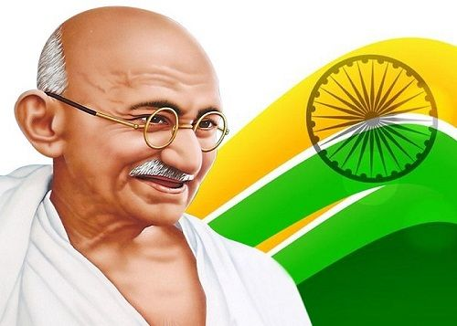
Direct Speech:
Quotes from Experts: Use direct quotes from credible sources to add authority and credibility to your argument.
2. Emotional Appeals: Incorporate direct speech to convey emotions and personal experiences, making your argument more relatable and engaging.
3. Rhetorical Devices: Utilize direct speech to employ rhetorical devices like repetition, metaphors, or allusions, which can be persuasive and memorable.
Example:
"As Mahatma Gandhi said, 'Be the change you wish to see in the world.' We must take action now to create a better future."

Slide 11
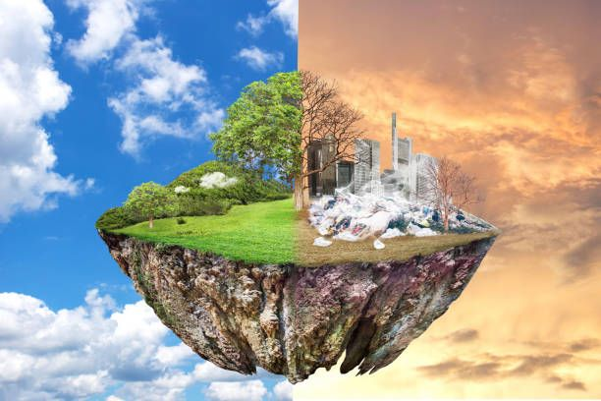
Indirect Speech:
Paraphrasing: Rephrase expert opinions or research findings in your own words to make the information more accessible and persuasive.
Summarizing: Use Indirect Speech to summarize complex information, making it easier for readers to understand and accept your argument.
3. Tone and Attitude: Employ Indirect Speech to convey a specific tone or attitude, such as urgency, excitement, or concern, to influence the reader's emotions and decisions.
Example:
“According to a recent study, most experts agree that climate change is a pressing issue that requires immediate attention. It’s time for us to take action.”

Slide 12
Combining Direct and Indirect Speech:
Blend quotes with summaries: Combine direct quotes with indirect speech summaries to create a persuasive narrative that balances authority with accessibility.
2. Use direct speech for emphasis: Incorporate direct speech to emphasize key points or emotional appeals, while using indirect speech for supporting evidence or explanations.

Slide 13
Example:
"As the renowned climate scientist, Dr. Jane Smith, said, 'The time for denial is over.' Indeed, the overwhelming majority of experts agree that human-induced climate change is a reality we can no longer ignore."
By strategically using direct and indirect speech in persuasive writing, you can create a convincing and engaging narrative that resonates with your audience.

Slide 14
Advocacy for Environmental Conservation
Direct Speech: “We need to act now to save our planet,” said the environmental activist.
Indirect Speech: She urged that immediate action was crucial to save the planet.
Combined: The environmental activist passionately stated, “We need to act now to save our planet.” She urged that immediate action was crucial to save the planet, highlighting the urgency of the situation.

Slide 15
Promoting Healthy Eating Habits
Direct Speech: “Eating more fruits and vegetables will improve your health,” the nutritionist explained.
Indirect Speech: The nutritionist emphasized that increasing fruit and vegetable intake would lead to better health.
Combined: The nutritionist explained, “Eating more fruits and vegetables will improve your health.” She emphasized that increasing fruit and vegetable intake would lead to better health, making it clear that dietary changes could significantly benefit everyone.

Slide 16


Slide 17

Philip said, “I was playing football.”
A. Philip said that he was playing football.
B. Philip said that he would be playing football.
C. Philip said that he had been playing football.
Philip said that he plays football.
2. Ranjan said, “You can not park here!”
A. Ranjan said that I may not park here.
B. Ranjan said to me that I was unable to park there.
C. Ranjan exclaimed that I couldn’t park there.
D. Ranjan forbade me to park there.
3. The boss said, “Call him right now.”
A. The boss shouted and said to call him right then.
B. The boss ordered me to call him quickly.
C. The boss told me to call him now.
D. The boss ordered me to call him right then.

Slide 18

4. “Wow! This is so beautiful.” Jacob said.
A. Jacob was surprised to see how beautiful it was.
B. Jacob said how beautiful it was.
C. Jacob exclaimed with amazement that that was so beautiful.
D. Jacob exclaimed with amazement that it was so beautiful.
5. Omar said, “I had always wanted to be a teacher.”
A. Omar said that he had always wanted to be a teacher.
B. Omar said that he had had always wanted to be a teacher.
C. Omar said that he have always wanted to be teacher.
D. Omar said that he wanted to be a teacher ever since.
6. Julia said, “I can not attend your wedding.”
A. Julia said that she might not attend our wedding.
B. Julia said that she could not attend our wedding.
C. Julia said that she can not attend our wedding.
D. Julia said that she wished she could attend our wedding.

Slide 19

ANSWERS
A
D
B
D
A
B

Slide 20
Convert Direct Speech to Indirect Speech with Descriptive Formulations
"I'm so excited to see you!" she said with a big smile.
"Don't worry, I'll be there," he said reassuringly.
3. "This is the best day ever!" the children exclaimed in unison.

Slide 21
ANSWERS
She exclaimed with delight that she was excited to see me.
He reassured me that he would be there.
The children chorused in unison that it was the best day ever.

Slide 22
Add Descriptive Formulations to Indirect Speech
1. He said he would attend the meeting.
2. She told me she was tired.
3. They asked if they could leave early.

Slide 23
ANSWERS
He promised confidently that he would attend the meeting.
She confessed wearily that she was tired.
They inquired eagerly if they could leave early.

Slide 24
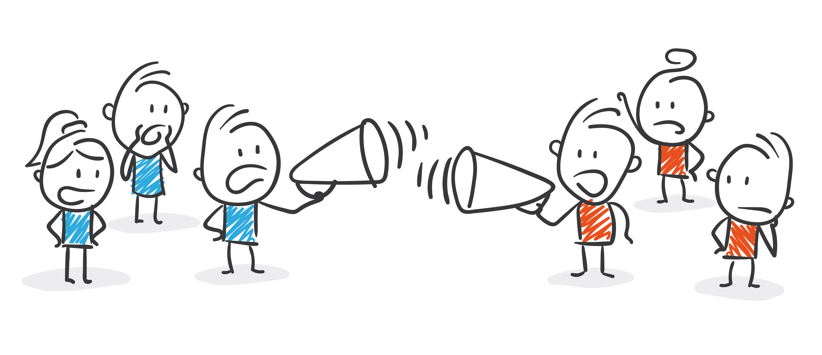
THANK YOU

